Slide 1
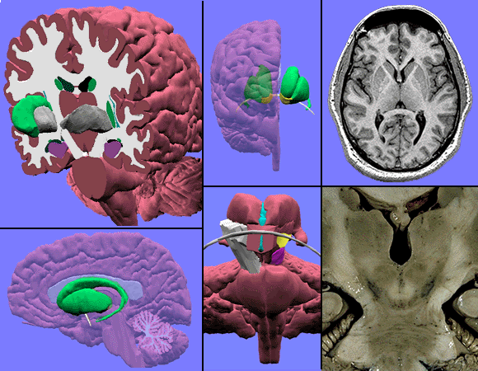
PSY600C NEUROPSYCHOLOGY
Developmental Neuropsychology, ADHD, & Autism

Slide 2
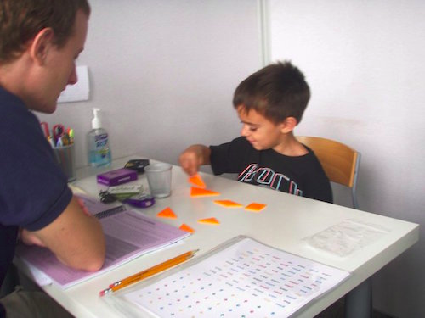
Plasticity – What is it?
The ability of neurons to change in form and function in response to alterations in their environment.
  Alterations in how the neuron responds to/influences other neuros
  Changes in neurons result in larger-scale changes in circuitry by alter

Slide 3
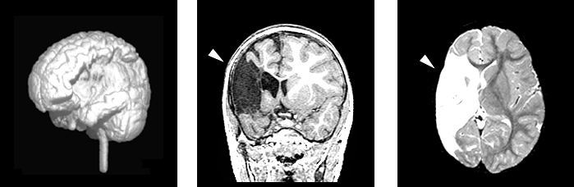
Plasticity in response to injury
Early injury suggests that the brain is
incredibly malleable
Even with rather severe damage…
Can see performance in the normal range

Slide 4
Factors Influencing Recovery
Severity – the worse the injury, the worse the outcome
Age
  Kennard principle? – the earlier the better
Domain impacted
  Language spared over other functions

Slide 5
Factors Influencing Recovery
Later developing deficits
Intelligence
  “It is not only the kind of head injury that matters, but the kind of head” (Symonds, 1937)
Multiple influences of plasticity
  “If you’re going to have brain damage, have as little of it as possible. Have it early, and have it on just one side. Be a girl, and come from a supportive family that lives near a good hospital.”

Slide 6
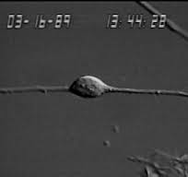
Neuronal migration
Process of neurons migrating from ventricular zone to cortical areas
Travel across brain via radial glial
Migratory route appears to be pre-programmed
https://www.youtube.com/watch?v=h3BoUpMjY-Y

Slide 7
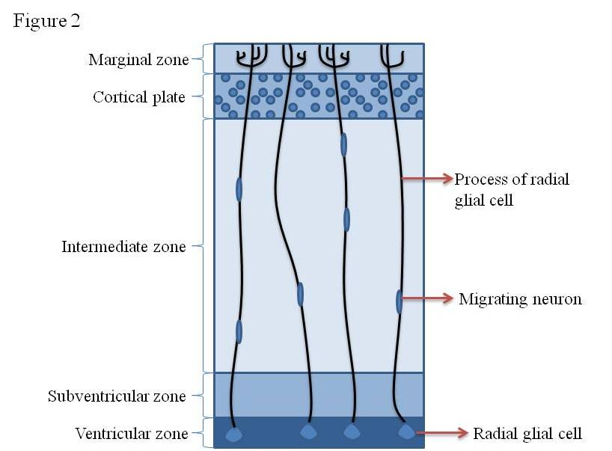
Neurons developed in the ventricular zone
Travel from ventricular zone to the pial surface
Migrate and become part of the network
If path is blocked, neuron’s won’t make it to its destined area

Slide 8
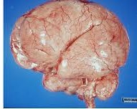
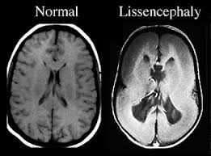
Lissencephaly “Smooth Brain”
Gene-linked brain mutation which significantly impacted neuronal migration

Slide 9
Synaptogenesis
Generation of synapses between neurons in the nervous system
Exuberant Synaptogenesis: From gestation to approximately 12 months of age where significant number of synapses are formed within the brain

Slide 10
Synaptic Pruning
Process of synapse elimination
As neuronal connections are unused, they are pruned away
  “Use it or lose it”

Slide 11
Early brain development
Growth is continuous, not step-wise
Infancy
  Large period of brain growth
    Vison nearly complete within a few months

Slide 12
Childhood through adolescence
Growth and development continues
  Rate of growth much slower compared to childhood
Some growth that continues into adulthood
Brain growth consists of:
  Developing of neuronal networks
  Increase in myelination

Slide 13
Adolescent & Teenage Years
http://www.ted.com/talks/sarah_jayne_blakemore_the_mysterious_workings_of_the_adolescent_brain?language=en
Brain changes in adolescence & teenage years
Adolescence: Time period when hormones start to influence the body & ends when individual becomes active contributor in society

Slide 14
Brain changes in adolescence
Gray matter changes
Development peaks around 10-12 years
Gray matter declines after this period
  Decline does not equal deficit

Slide 15
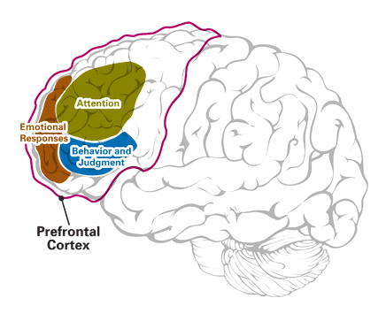
Prefrontal Cortex Development
PFC larger in humans than all other species
PFC plays significant role in social interactions
  Social inhibition, social awareness,
  planning, organization,
  self-awareness
PFC undergoes rapid growth
and development during
adolescence

Slide 16
Functional change of adolescence
Limbic system regulates emotional processing and reward processing
  In childhood limbic system over-rules inhibition
Decrease in medial PFC growth in adolescence
  Increases efficiency of PFC’s ability to regulate limbic system

Slide 17
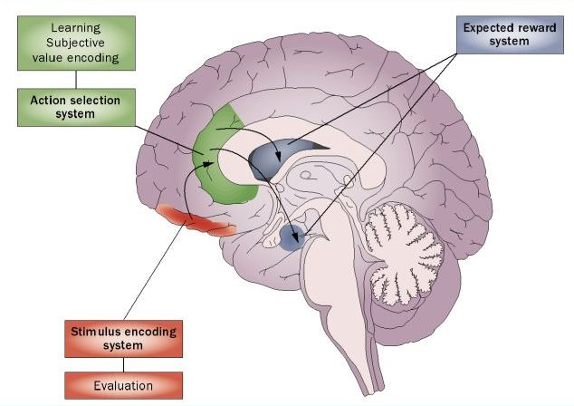

Slide 18
Functional changes in adolescence
Increase of executive skills: see things from someone else’s perspective, planning, organization, response control
Process is generally consistent throughout generations
  One generation not more mature than the next
    “Good old days” fallacy

Slide 19
Autism Spectrum Disorder
Persistent deficits in social communication and social interaction across multiple contexts
  Social-emotional reciprocity
  Use of Nonverbal communicative behaviors to regulate social interactions
    Eye-contact - Body Language - Facial Expressions
  Deficits in developing, maintaining, and understanding relationships

Slide 20
Autism Spectrum Disorder
Restricted/repetitive patterns of behavior, interests, or activities
  Stereotyped or repetitive motor movements
  Difficulty adapting to changes in routines
  Highly restricted, and fixated interests of abnormal in intensity
  Hyper- or hyporeactivity to sensory input
  https://www.youtube.com/watch?v=xp2sZeosrhE

Slide 21
Autism Spectrum Disorder
ASD does not require cognitive impairment
  Historical figures potentially with ASD
  Newton, Einstein, Picasso, Lewis Carrol, Temple Grandin
ASD can mask cognitive skills

Slide 22

Autism
Etiology is still unclear. Maybe…
  Brain overgrowth
  Abnormal neuroanatomical development:
  - including theory that larger brains are more
  specialized
    Marcel Just, a neuroscientist at Carnegie Mellon University “Distinct brain areas work independently. People with autism are good at details but bad at conceiving the whole.’’
  Localized damage
  Perinatal influences (cell growth abnormality)
  Polygenic component
Notes:
Language = single words by two, phrases by 3

Slide 23
Neuroanatomy
Multiple models
  Slightly different areas of dysfunction may be associated with different presentations on the spectrum
The most promising findings suggest abnormalities associated with the:
  Wide spread abnormalities in neural growth & cell migration leading to increased brain size & malformations in the cerebral cortex
  Cerebellar functioning
  Limbic system
  Amygdala

Slide 24
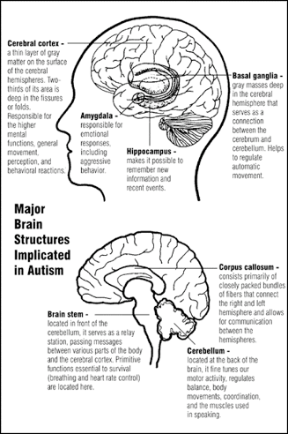
Cerebellum…a posthoc structure?
Found to be generally smaller in patients with autism.
Associated with
coordination of movement
The cerebellum has been long known for its importance in motor learning and coordination. Recently, anatomical, clinical, and neuroimaging studies strongly suggest that the cerebellum supports cognitive functions, including language and executive functions, as well as affective regulation.
Notes:
Olfactory cortex, amygdala, & hippocampus

Slide 25
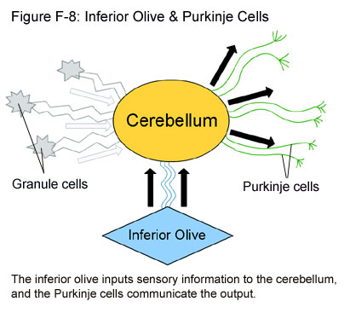
Inferior Olivary Complex
Largest nuclear group in the brain stem
Has an intimate association with the cerebellum suggesting it is involved in motor coordination
Suggests autism neurodevelopmental link around 28-30 weeks gestation
Notes:
Olfactory cortex, amygdala, & hippocampus

Slide 26
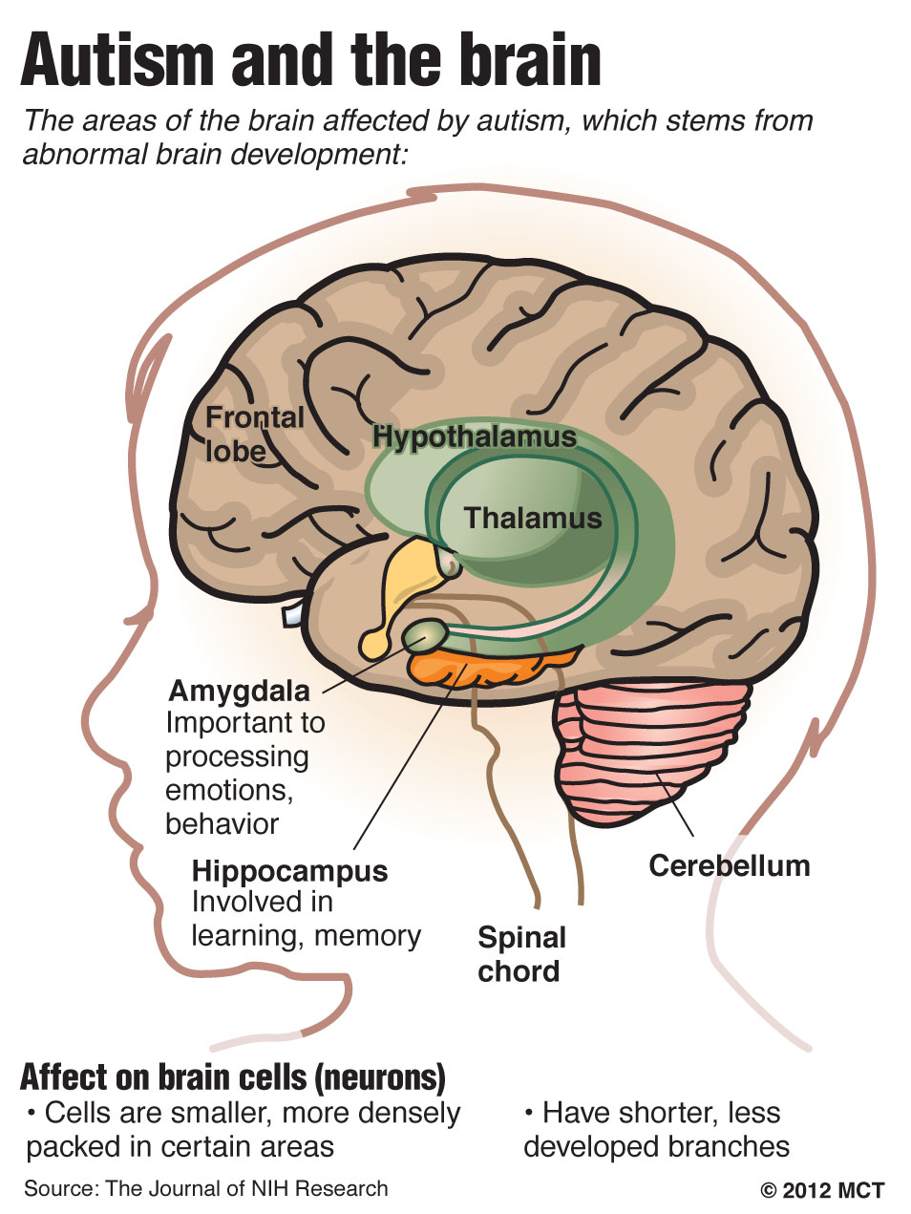
Hippocampus
Learning and memory
Damage often leads to inability to store new information into memory
Regarding autism, the inability to relate new info to stored info is questioned
If damaged or removed, animals display stereotypic, self-stimulatory behaviors.

Slide 27
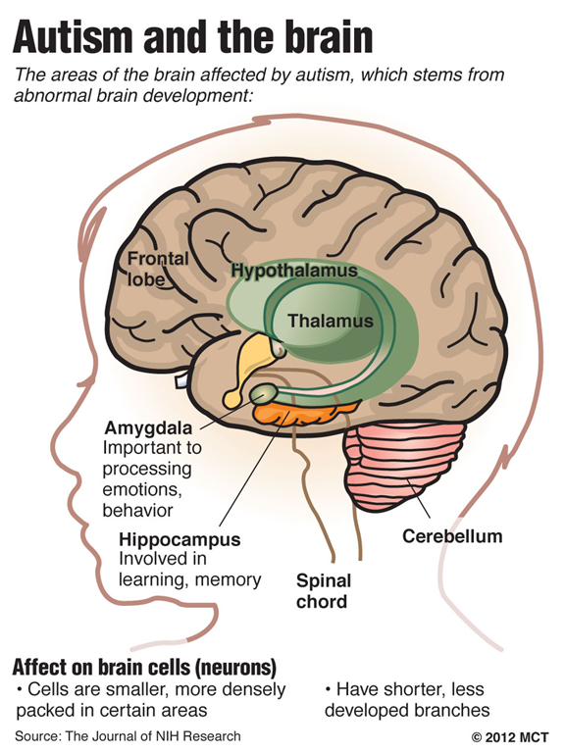
Amygdala
Has been described as being the “social brain”.
Involved in producing and responding to nonverbal signs of anger, avoidance, defensiveness & fear.
After surgical removal, negative emotional signs tend to lose their meaning.

Slide 28
ASD Social Brain Differences
Imaging results have studied the superior temporal sulcus (STS) & fusiform gyurs
ASD children display reduced sensitivity to biological motion
ASD children have a decreased attention to all human faces

Slide 29
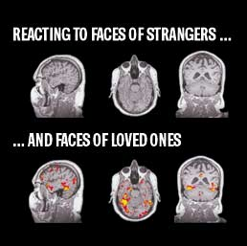
However, there are some promising finding (e.g. not all faces are created equal….. )
Autistic brains don't react to
facial cues the way control
brains do
But, when faces of strangers
are replaced by faces of loved
ones, the autistic brain looks
very similar to a control brain
(Pierce et al, UCSD)

Slide 30
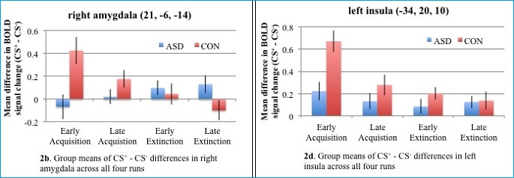
What about responses to non-faces in the environment
In controls, the amygdala responded strongly to the “threat” color early in the first half of the exercise. This is the expected response when the brain is learning to recognize a new “danger.” The brain activity in these two regions then faded away across the extinction portion of the exercise – as it became clear that no more disquieting puffs of air were in store.
By contrast, a very different pattern arose among the participants affected by autism. Their brains’ danger-recognition centers responded weakly at best when introduced to the new danger cue. (Blue bars in figure 3 below.) Then, during the fear-extinction part of the exercise, brain activation continued to remain strong – even increase – in the amygdala and insula, when just the opposite should be happening.

Slide 31
Developmental Nature of ASD
ASD symptoms often become apparent around 2 to 3 years of age
Early intervention leads to the most positive long-term outcomes

Slide 32
Autism Spectrum Disorder
Not caused by vaccinations
Deficit in social communication, not necessarily intellectual functioning
Related to abnormal activity
  Cerebellum
  Social brain mechanism
Imaging/genetic testing are helping to identify ASD earlier, which can increase efficacy of interventions

Slide 33
ADHD – Diagnostic Criteria
Inattention
  Avoiding tasks
  Distractibility
  Unable to pay attention to details
  Difficulty with focus
  Poor direction following

Slide 34
ADHD – Diagnostic Criteria
Hyperactivity/Impulsivity
  Fidgeting
  Trouble staying seated
  Excessive movements
  Talking excessively
  Trouble waiting to take turns

Slide 35
ADHD & the Brain
ADHD highly genetically correlated
A genetic variation that boosts ADHD risk also appears to predict who may “grow out of it”
Brain differences found in ADHD children at 8, but normalized by 16
  Started w/ unusually think cortex in attentional areas
    Polymorphisms of the dopamine D4 receptor
  Over time their brains normalized and was indistinguishable from peers
Links ADHD to genetically determined pattern of brain development
Shaw, P., Gornick, M., Lerch, J., Addington, A., Seal, J., Greenstein, D., ... & Rapoport, J. L. (2007). Polymorphisms of the dopamine D4 receptor, clinical outcome, and cortical structure in attention-deficit/hyperactivity disorder. Archives of General Psychiatry, 64(8), 921-931.

Slide 36
ADHD - Neuroanatomy
However, multiple studies have failed to reveal anatomical brain differences (explanations?)
Possible link to prefrontal, frontal, limbic areas, basal ganglia, striatum, caudate nucleus and motor areas

Slide 37
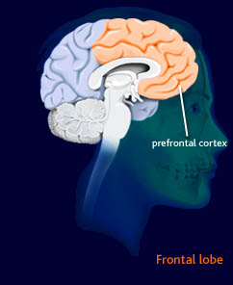
Prefrontal Cortex
Associated with:
Complex cognitive processes
And the expression of personality & appropriate social behavior

Slide 38
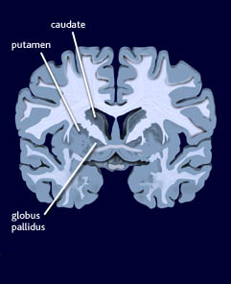
Caudate Nucleus
Associated with:
Initiation & inhibition of movement
Thought to be involved in the motor inhibition part of ADHD

Slide 39
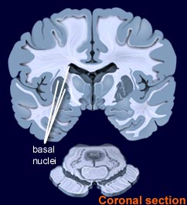
Basal Ganglia
Associated with poor- modulation of limbic activity (emotional
expression) and
cognition involving
prefrontal association
cortex
Notes:
grouped collection of large subcortical masses located deep within each cerebral hemisphere, The corpus striatum is a structure encompassed within the basal ganglia

Slide 40
Functional more promising than structural
in ADHD
Lots of neuropsych abnormalities (attention, inhibition)
Abnormalities in late components on ERP on tasks of vigilance also suggest prefrontal influence
CBF measures suggest decreased blood flow to prefrontal regions and to the limbic system

Slide 41
But…….
Some research (2010) suggests that it may be more about immaturity, not a “disorder”
“Nearly 1 million children may have been misdiagnosed with attention deficit hyperactivity disorder, or ADHD, not because they have real behavior problems, but because they're the youngest kids in their kindergarten class, researchers say.”
http://www.usatoday.com/news/health/2010-08-17-1Aadhd17_ST_N.htm

Slide 42
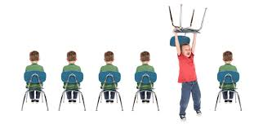

ADHD & Cognition
ADHD is not associated with cognitive impairment
  Impact performances, not skills

Slide 43


ADHD Treatment
Combination of medications and environmental structuring is most efficacious

